Slide 1
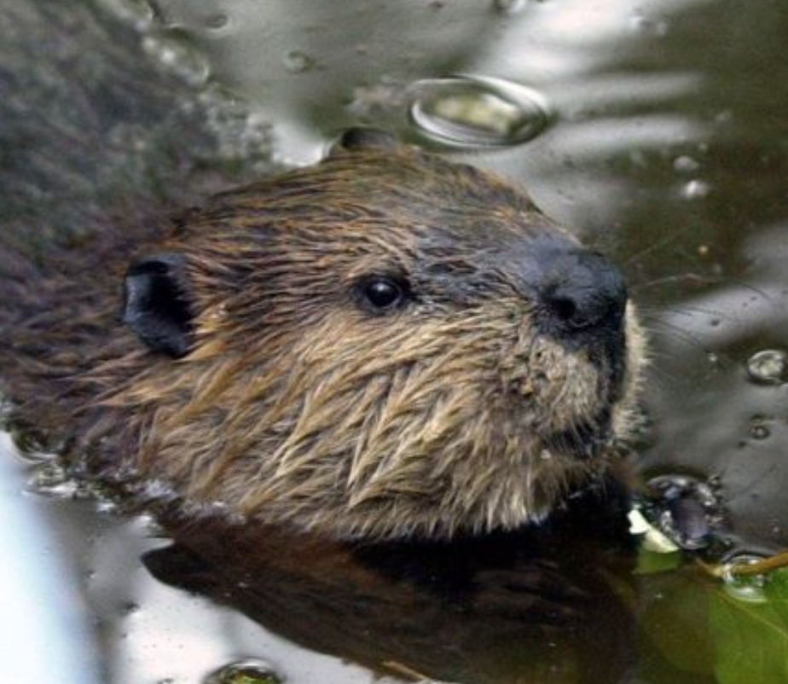
Beavers
By: Eva Robinson

Slide 2
Introduction
How Long Does a Beaver Live?
Semiaquatic Rodent
Primarily Nocturnal
Builds Dams, Canals and Lodges
Hover Curser Over Icon to View Movie

Slide 3
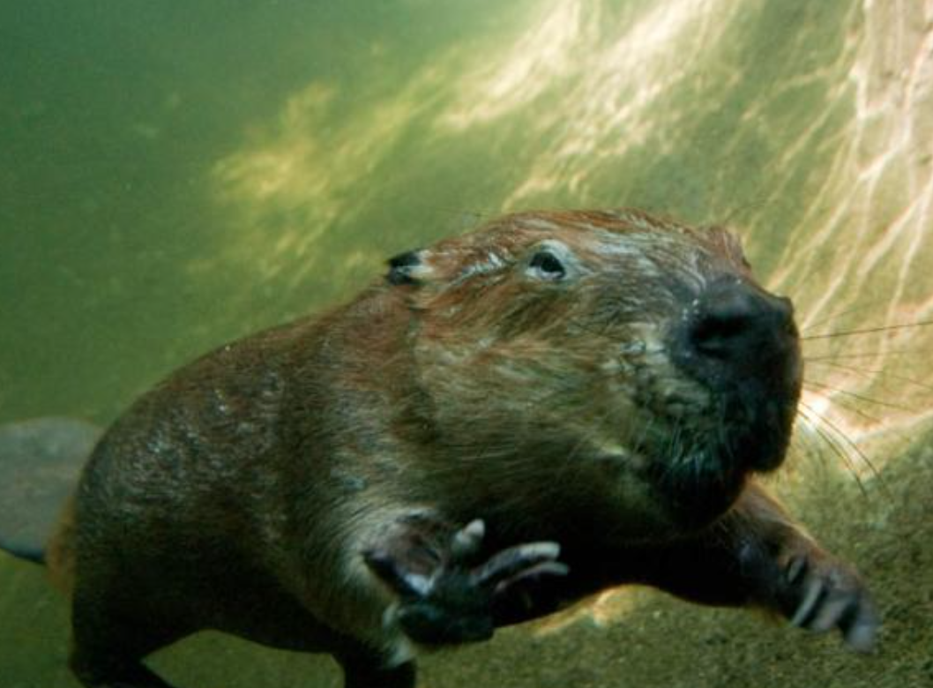
Characteristics
Freshwater Animals
Dark Brown Waterproof Fur
Transparent Eyelids that Act as Goggles

Slide 4
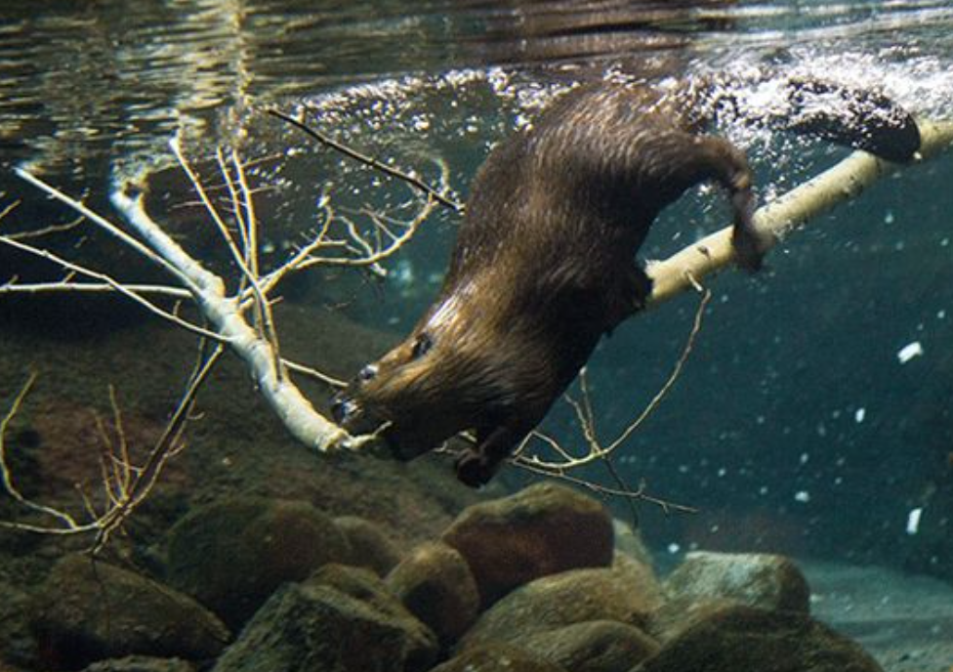
Habitat
Materials to Build Dams
Is a breaking Dam a Problem?
Needs Water. How long can a beaver Hold its Breath Under Water?

Slide 5
Conclusion
Endangered?
Are Dams Good for the Environment?
Would a Beaver Be a Good Pet?

